Slide 2
Who Are We?
Miss Lewis
Mrs Weston (TA)
Mrs Thurgood (PPA Cover and Outdoor Learning)
Mrs Peake (French/Spanish Teacher)

Slide 3
Welcome to Year 3
This presentation will give you useful information about Year 3 for the term and the year ahead.
Should you have any questions or queries at any point, please either email year3@wildmoorheath.org.uk or leave a message with the office.

Slide 4
Morning Routines
Children arrive between 8:40-8:50am. They will complete a morning activity to settle them ready for the day. This could include handwriting, spellings times tables etc.
Children are allowed to have a healthy snack for play time and please ensure all children have a water bottle.

Slide 5
Transition from Infants to Juniors
As the children are now in the Juniors, we will be developing their independence skills. Children will take more responsibility for their belongings and ensuring they have everything they need.

Slide 6
Class Charters and Rewards
Class Charter – At the start of the year, children created their class charter which forms the class rules each child have agreed to follow.
House Points – House points will be awarded to children who follow the school values by showing polite manners, positive teamwork or excellent effort.
Celebration assembly – Every Friday a celebration assembly will be held where children may receive a certificate for being the Star of the Week.

Slide 7
The Year 3 Curriculum
Autumn – Stone Age
Spring – Polar Explorers
Summer – Our Local Area

Slide 8
Experiences
Throughout the year, we will have different experiences for the children to participate in -
Autumn – Local Heath Walk
Spring – Sleepover (further information will be given closer to the time)
Summer – Swimming (further information will be given closer to the time)

Slide 9
Autumn Term -

Slide 10
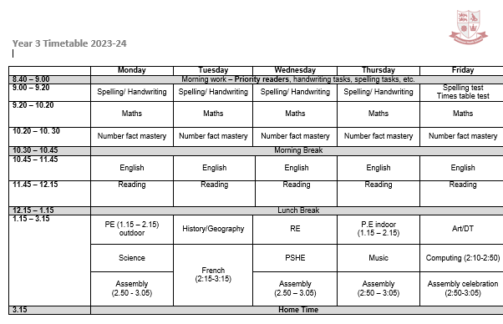
Class Timetable

Slide 11
PE days are Monday (outdoors) and Thursday (indoor)
Please ensure your child has a named PE kit that remains in school throughout the week. Earrings needs to be removed and long hair tied back.
Outdoor learning will take place in Spring 2. Further information will follow closer to the time.

Slide 12
Website
www.wildmoorheath.org.uk/page/?title=Year+3&pid=103
The class page, which is accessible via the school website, will be updated regularly.
We will also provide information about the maths and reading strategies that we will be using in class so that you can support your child with their home learning.

Slide 13
Bookopoly
Bookopoly is one of the strategies we use in KS2 to encourage a love of reading. Your child will choose a book from the class library to take home to read. The book should be brought into school every day so children can continue to read if they have the opportunity.
Children can change their reading books as and when they complete a book. To ensure children have understood what they have read, we ask that children have their book for a minimum of 2 nights before changing it.

Slide 14
Home Learning
Each week your child should complete:
Reading – Daily reading with their school book.
Spelling – Daily spelling practice using Spelling Shed
Times Tables – Daily times tables practice on TTRS

Slide 15
Drop Off and Pick Up
In the mornings I will be the hall door where the children enter the school if you need to speak to me.
For Pick Up, please can I ask that you stand near the gate to make it easy when releasing your child.
If someone different is picking up please let the office know.

Slide 16
Thank you for coming
Any questions?

