Slide 1

Welcome to Year 3
Woodpeckers

Slide 2
Welcome to Year 3
This presentation will give you some useful information about Year 3 for this term and the year ahead.
Should you have any questions or queries, please either speak to me at drop off /pick up, email me at year3@wildmoorheath.org.uk or leave a message with the office.

Slide 3
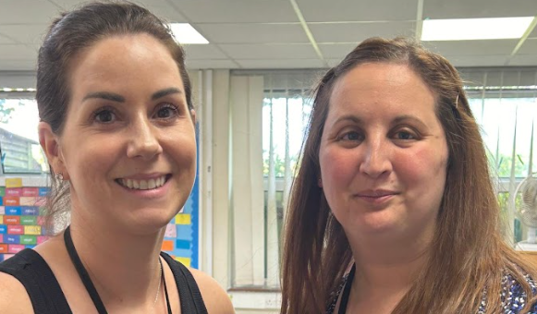
The Year 3 Team
Miss Lewis
Class Teacher
Miss Farrell
Student Teacher
Miss McInally
Class TA
Mr Jackson
Class TA
Ms Foxley
PPA Cover

Slide 4
Morning Routines
Children should arrive between 8:35am and 8:45am. They will complete a morning activity to settle them ready for the day. This may be times tables, handwriting, spellings etc.
Children need to bring a healthy snack for playtime – they do not get fruit like they did in the infants.
Please ensure all children have a labelled water bottle.

Slide 5
Transition from Infants to Juniors
As the children are now in the Juniors, we will be developing their independence skills. Children will take more responsibility for their belongings and ensuring they have everything they need.

Slide 6
Year 3 Curriculum – Themes
Autumn Term – Local Area History and Geography
Spring Term – Stone Age
Summer Term – Bronze Age, Iron Age and Celts

Slide 7
Year 3 Curriculum
English, Maths and Reading are taught daily through structured lessons.
Reading books will be changed as and when children finish them. We ask that you have the book for at least 2 nights before the book is changed.
There is an emphasis on vocabulary and speaking and listening skills which will be used in all areas of the curriculum.

Slide 9
PE
Indoor PE lesson is on Tuesday and Outdoor PE is on Wednesday
Please ensure that children have a PE kit in school at all times containing clothing relevant to the weather. Tracksuit bottoms and a jumper are essential during the winter months as we will be going outside for PE whatever the weather.
Children will need a pair of named trainers in their PE kit bag at all times.
No jewellery allowed during PE lessons. Children either need to come into school without jewellery or be able to remove them themselves.

Slide 10
School Bags
Small school bag for their spelling book, reading record, lunchbox (if relevant), one healthy snack and water bottle.
Please do not send in any personal items from home such as toys or pencil cases, all resources will be provided for the children.
Please ensure that your child has a change of outdoor shoes (wellies/trainers) and a waterproof jacket in school everyday, a fold away pack-a-mac that can stay in their locker all year would be ideal.
Please ensure that all clothing is clearly named.

Slide 11
Home/Reading Folder
Reading Record
Current reading book- changed when finished.
Sound mat containing all the sounds we have taught
Common exception words
Number bonds
Please feel free to use them to support your child at home
Please ensure they are kept in your child’s folder as we can use them at school too

Slide 12
Home Learning
In Year 3, it is expected that children:
Read daily. Every child will bring home a reading book.
Practise counting in 3s, 4s and 8s – We will have a times tables test on a Friday.
Spellings on Spelling Shed or in their spelling books (spellings will be set on a Friday for testing the following Friday)
Spellings should be practised frequently at home using ideas from the spelling honeycomb to support learning.

Slide 13
How to help at home
Encourage speaking and listening skills.
Share lots of books and encourage children to read daily.
Let your child see you reading, writing and doing maths – can they help you with a shopping list and work out the change for something you buy?
Spelling - common exception words from the Year 3 and 4 spelling lists.
Practise recognising and writing numbers to 100 and recalling number bonds.

Slide 14

Bookopoly
Bookopoly is a reading for pleasure system we use in KS2.
When children are at a certain reading level, they will be able to play bookopoly. Children choose a book from the bookopoly trolley, take it home to read and return it when finished with a completed book review sheet. The idea is to see how many books children can read throughout the year,

Slide 15
Useful Information
Children will need a water bottle (filled with water only) and a coat every day.
Please name all items of clothing.
Our Library session is on a Monday

Slide 16
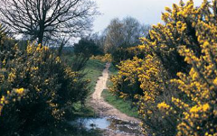
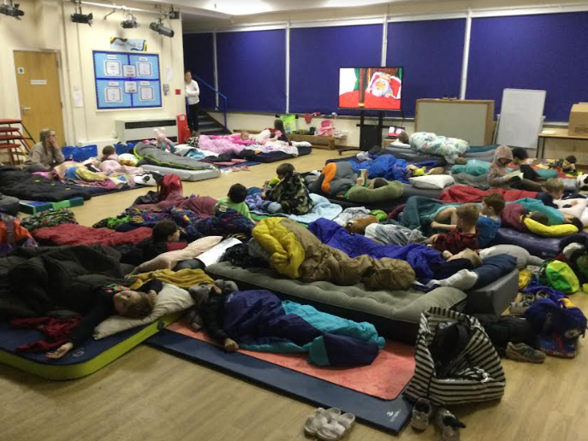
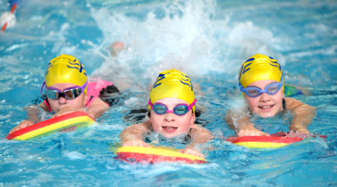
Trips/Visits/Experiences
Heath Walks – throughout the year.
Sleepover – Spring Term (information will follow closer to the time)
Swimming – Summer Term (information will follow closer to the time)

Slide 17
Communication
Please ensure the office has your up to date contact details so you can receive communications from school.
I will be on the gate most days and available after school.
Make an appointment via the office
Please feel free to contact us via email year3@wildmoorheath.org.uk.

Slide 18
Thank you for coming!

